Slide 1


APPLICATION OF AI AND DEEP LEARNING IN POWDER METALLURGY
Ayushmaan Jaiswal 210005012

Slide 2
CONVENTIONAL METHODS IN P/M
01
04
Metal Infiltration
Mixing
02
05
Cold Pressing
Compaction
03
06
Hot Pressing
Sintering with Atmosphere Control

Slide 3
CHALLENGES WITH CONVENTIONAL METHODS
REQUIREMENT OF EXPERTISE
Selecting the right powder and process parameters for PM requires expertise from multiple specialists.
USE OF REGRESSION ANALYSIS
This method creates statistical models based on past data to predict outcomes like sintered density or mechanical properties. However, it has limitations:
Simplification
Non-linearity
Multiple Properties
Data Requirements

Slide 4
CHALLENGES WITH CONVENTIONAL METHODS
P/M DATA UTILIZATION
PM data often has:
Significant scatter (variation)
Multiple possible combinations of input parameters to achieve desired properties
Gaps in available data
EXPENSIVE EXPERIMENTATIONS
Many trial and errors are done for the desired properties to be attained, this makes it a cost extensive way. Even with these many experimentations accuracy is not that high.

Slide 5

HOW AI HELPS ?
1
AI-powered material selection : Deep learning algorithms can analyze vast amounts of data on powder properties, process parameters, and desired final properties, accordingly it reccomends material selection
2
Modelling non-linear relationships : Deep learning models like neural networks excel at handling non-linear relationships.
3
Data driven process optimization : AI and deep learning can analyze data from past production runs to identify trends and optimize process parameters for better results.
4
Knowledge-Based Systems : AI can be used to create knowledge-based systems that capture and store expert knowledge about PM.
5
Improved accuracy : Specific soft computational tools/ neural networks help improve accuracy, and large number of trial and errors are not required.

Slide 6
DEEP LEARNING AND NEURAL NETWORKS
WHAT ARE NEURAL NETWORKS ?
HOW NEURAL NETWORKS WORK ?
Neural networks, inspired by the human brain, are made up of interconnected nodes arranged in layers. These nodes process and transmit information, mimicking how our brains learn patterns.
Its structure consists of input, hidden and output layer.
NNs learn through a process called training, where its fed with large datasets.
Each neuron in the network uses an activation function to the data it receives from previous layers and it helps determine how the neuron "fires" and transmits information to the next layer.
WHY NEURAL NETWORKS ARE BETTER ALTERNATIVES ?
They don’t require predefined assumption.
Can handle multiple variables and provide multiple combination.
Learn from data and continuously improving it’s approach.
Superior Dataset handling.

Slide 7
STATISTICAL MODEL V/S NEURAL NETWORK
FEATURE | STATISTICAL MODEL | NEURAL NETWORK
Underlying Relationships | User needs to define the mathematical relationships between input and output variables. | No need to pre-define these relationships. Learns from data.
Input Complexity | Limited to handling a few input variables | Can handle multiple input criteria (desired mechanical properties).
Output Recommendations | Typically provides a single "best" solution | Provides multiple potential solutions (different powder compositions and process settings)
Flexibility | Less adaptable to new data or complex relationships | Continuously improves with more data and can handle non-linear relationships
Underlying Assumptions | Relies on pre-defined assumptions about data behavior | Minimizes assumptions, leading to potentially more accurate results

Slide 8


PROCESS
01. Data Collection and Preparation
02. AI Model Selection and Training
Data Gathering: The process starts by collecting data from past PM production runs.
Data Cleaning and Preprocessing: The collected data may require cleaning and pre-processing to ensure accuracy and consistency.
Network Architecture: Choose an appropriate AI model based on the complexity of the data and desired outcomes. this involves defining the number of layers, the number of neurons in each layer, and the type of activation functions used.
Training Process: The prepared data is then used to train the neural network.

Slide 9
PROCESS
03. Prediction and Optimization
04. Model Evaluation and Refinement
Evaluation: Evaluate the model's performance on the testing set, which was not used for training. This helps assess the it’s generalizability and ability to predict properties for unseen data. Common metrics like mean squared error or root mean squared can be used for evaluation.
Refinement: If the model's performance isn't satisfactory, refine it by, modifying hyperparameters or the model architecture. Collecting more data to improve training.
Prediction: Once trained, use the model to predict the final properties of PM parts for new or unseen material compositions and processing conditions.
Optimization: Use the predictions to optimize the PM process. Identify the combination of material composition and processing parameters that will achieve the desired properties for your specific application.

Slide 10
SIMPLIFYING THE POWDER METALLURGY MANUFACTURING PROCESS USING SOFT COMPUTING TOOLS
Problem Associated:
Designing in P/M Labs often involves expensive experimentation and can be risky due to unknown properties of the final product.
Solution Proposed:
The paper proposes using soft computing tools like neural networks and fuzzy logic to predict properties during designing phase.

Slide 11

Short Comings of Existing Computing Techniques
Limited Prediction: Most prior research focused on predicting only a few linear parameters.
Trial-and-error architecture: Model structure was often determined without clear optimization.
Overfitting: Models might memorize training data without generalizing well to unseen data.
Null data handling: Inability to handle missing values (null entries) in the data.
Biased accuracy measures: Use of biased metrics like correlation coefficient instead of unbiased measures like Average Absolute Relative Error (AARE%).
Slow convergence: Existing models required excessively long training times.
New Soft Computing Tools Used Here:
1) PRNET Model : PCA - Radial Basis Function neural network.
Principle Component Analysis : This is a dimensionality reduction technique that identifies the important underlying variables in a high-dimensional dataset.
Radial Basis Function (RBF) Neural Network : This is a type of artificial neural network that uses radial basis functions as activation functions in its hidden layer.
2) Fuzzy Logic : Fuzzy logic system is intended to refine or adjust the input ranges for the RBFNN model based on the fuzzy rules and input values.

Slide 12
Procedure Followed Here:
1) Data Preparation :
Handling Missing Data : The raw data available often has some missing data, which earlier were tackled either by omitting the entire cell or substituting with 0, but now it is substituted with mean value of the column.
Data Normalization/De-normalization : Data is normalized for making the data more uniform, which speeds up the learning of model. Later the data is converted back to by de-normalizing.
Data Splitting : Data is divided into training set, validation set(optional) and testing set.
2) Network Structure :
Input/Output Parameters : The original data consists of 21 parameters. 10 parameters are chosen as input features for the model. The remaining 11 parameters represent the desired outputs
Model Design : Input layer size (x): Determined by the chosen reduction process . Hidden layer size: Fixed at 350 neurons. Output layer size: 11 neurons, corresponding to the 11 output parameters.
Training Algorithm : RBFNN uses large number of hidden neurons for perfect mapping since many combinations are to be covered.
3) Fuzzy Logic :
RBFNN does not give a specific range of parameters, as tries covering large number of possibilities.
So the fuzzy logic comes in handy to refine and adjust input ranges, increasing the feasibility of procedure

Slide 13
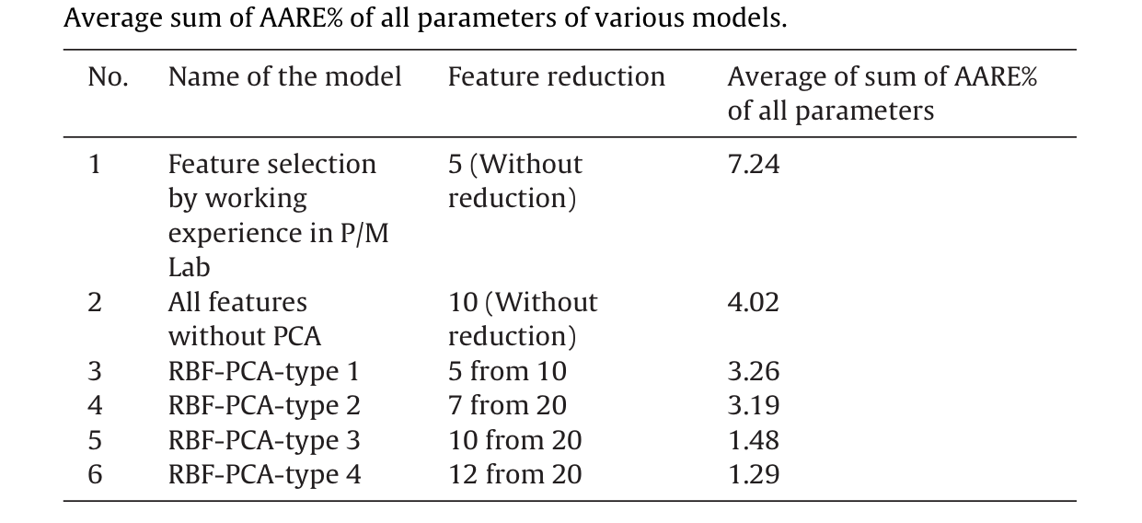
Comparing Accuracy For Various Methods:
The least error observed here is in : RBF-PCA-type 4, with only 1.29% error
The most error observed here is in: Experienced Specialists, with 7.24% error

Slide 14
A NEURAL NETWORK APPROACH FOR SOLUTION OF THE INVERSE PROBLEM FOR SELECTION OF POWDER METALLURGY MATERIALS
What Is Inverse Problem?
The term inverse problem refers to the task of employing process output information in order to recommend suitable input settings for the process concerned, we are solving inverse problem for Fe P/M materials.
What Are The Previosuly Used Methods
Previous attempts at solution of the inverse problem have involved the use of statistical methods for fitting curves to the available experimental data. The resulting equations can be combined in a rule-base for generating materials selection advice

Slide 15
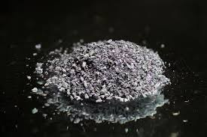
INTRODUCTION
Why AI IS Required In Powder Metallurgy
to provide quality assurance, and to reduce the costs and lead times of their products
future valuation of manufacturers is likely to be increasingly based not upon their material capital assets, but upon how deep, wide-ranging, and up-to-date their process related knowledge is considered to be.
AI techniques like neural networks can reduce lead times and costs by providing timely materials-related advice.
Neural networks can effectively model the often non-linear empirical data held by manufacturers.
Accurate control of chemical composition, compaction, and sintering parameters is crucial when manufacturing parts from powdered metals to achieve desired density, strength, and dimensional specifications.
In the case of P/M, computers are mostly employed for simple statistical analyses and computerised draughting

Slide 16

Parameters that to be optimized are-
Flow Behavior And Deformation
Kinematics Of Powder Particles
Relative Fractional Packaging Density
Shrinkage During Sintering
Hybrid Space KBS is used to utilize the benefits of modelling techniques such:
Neural Networks
Rule Based Analysis
FEM
TAGUCHI Method
Neural Network Approach To Selection Of Engineering Materials.

Slide 17
Employment of mechanical properties as selection criteria for P/M materials
1) Powder Metallurgy Materials Have To Be Chosen According To:
Tensile Strength, Impact Energy of final product
The traditional method of relating requirements to available materials has involved reference to look-up tables
In an attempt to reduce the amount of labour involved, data- bases have been developed for P/M materials selection
However, these systems are limited to recommendations based on existing powder blends
In order to overcome this limitation statistical methods have been used to fit curves to experimental data, followed by incorporation of the result- ing equations in a knowledge based P/M materials selector

Slide 18
WHAT ARE THE DISADVANTAGES OF PREVIOUSLY USED METHODS
Data related to powder metallurgy routes has high noise levels and multiple input
Fitting non-linear data is challenging when multiple inputs are involved.
Regression analysis is inefficient in the presence of significant noise.
What Are The Remedies Of This?
Multiple inputs, modelling of highly non-linear responses, and the avoidance of detrimental noise effects have been provided by training a backpropagation neural network with experimental data for ferrous P/M data.

Slide 19
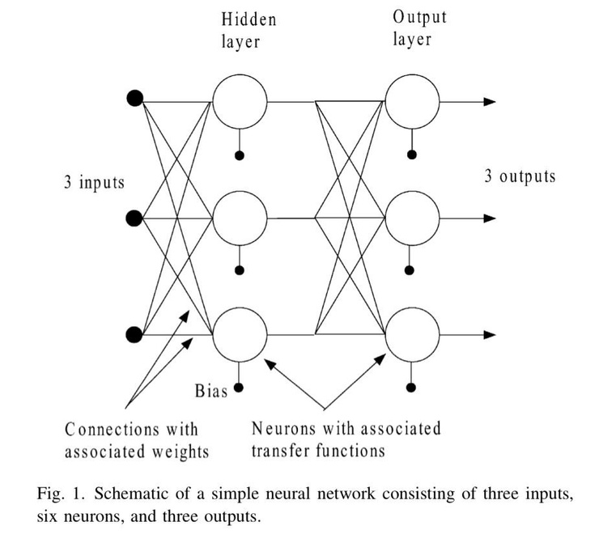



FUNDAMENTAL NEURAL NETWORKS
A neural network is a parallel computing method that provides a simple artificial analogy to biological nervous systems.
As shown in Fig. 1, a neural network is comprised of a number of inputs, hidden layer neurons, and outputs.
Each connections have the corresponding weight. The values of these weight are where the network model is stored.
Neurons = transfer function + Bias
QUESTION:
how NEURAL NETWORK is actually trained ?
.Non-linear responses can be modelled through the use of suitable transfer functions.
Hidden layer neurons often employ sigmoid transfer functions to relate a wide ranging input to a finite output range, while the output neurons are usually linear.
Bias is a signal that is added to the input signal to displace the curve of the neuron’s transfer function
This is done via supervise learning , in supervise learning weights are adjusted.
Weights are adjusted by comparing output and target values number of time and altering the weights each time so as to minimize the error.

Slide 20
MANUFACTURING APPLICATIONS
2
4
Injection Molding
Spray Panting
Modelling of Powder Packing
3
5
1
Selection of Engineering Material
Milling
Here low order polynomial curve fitting is generally unsatisfactory.
Here analytical solutions are usually unavailable
Neural networks are useful for predicting responses for such system which have above 2 properties.
Q) Why neural networks are used in modelling of mechanical behavior of powder metallurgy material ?
(explain)

Slide 21
System Implementation
The MATLAB neural network toolbox has been used to develop a materials selector for ferrous P/M materials
Input required mechanical properties.
Output required recommend the material density and percentage carbon content needed to attain the properties through P/M manufacture.

Slide 22
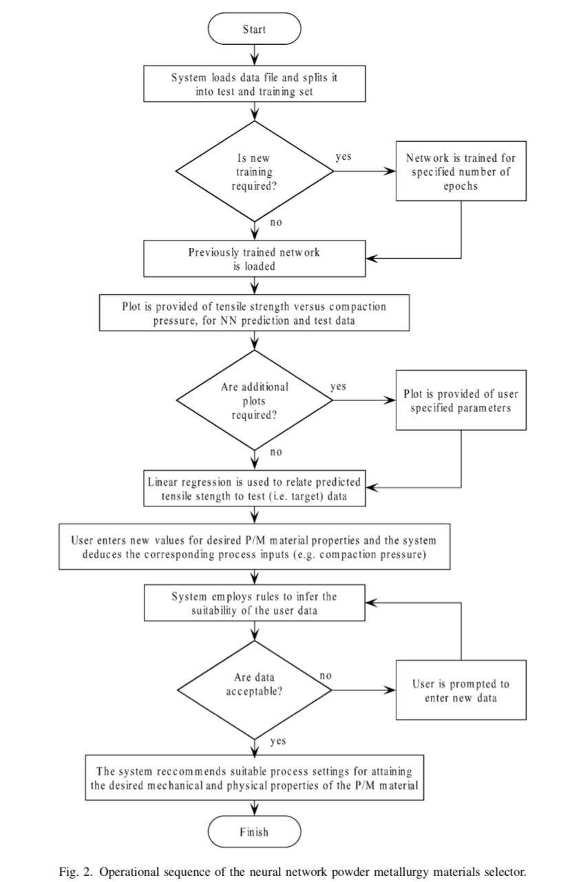

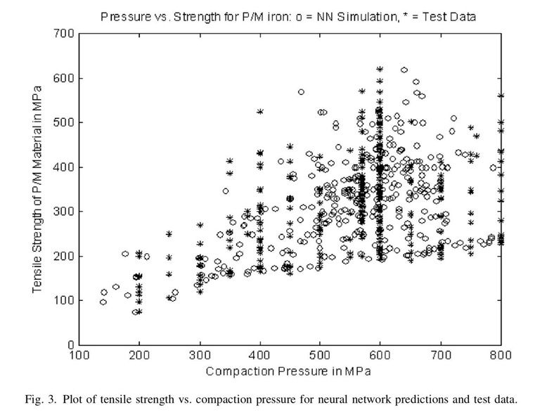
The user is first asked if a new training operation is required, and if the answer is yes training is initiated with the parameters set by the user, otherwise a previously trained network is loaded
The system also offers the user the choice of plotting any combination of input and output parameters
.input=elongation ,hardness,density,tensile strength,dimenstional change
output(5)=compaction pressure,sintering temperature,sintering time, %C,%P
Regression analysis gives us empirical equations to relate predicted data and original data; correlation coefficient=0.9+
Note: This graph is made for a network which is trained with 10000 epoch.
The resilient backpropagation algorithm was employed in order to achieve relatively fast network training.
A plot of error (i.e. the difference between predicted and target outputs) versus number of epochs was provided to monitor training

Slide 23



UTILITARIANISM OF REGRESSION ANALYSIS:
01. Conventional Statistics
03. Further Explanation
Used for :
Preliminary analysis of the P/M mechanical property data to check for general trends for data .
For generation of rules used to check the users input data.
when the user enters the required values for tensile strength, elongation, and hardness.
Strength and elongation and the predicted value of hardness is compared to the specified value
02. Examples
Suppose the regression equation previously made by statistics
g=0.321a - 1.24b + 13.4
g is the hardness (Vickers), a the tensile strength (MPa) and b the percent elongation.
04. Conclusion
The resulting percentage error is used to guide the user regarding the reliability of the network prediction
Notes:
hh

Slide 24

COMPARISON OF STATISTICAL AND NEURAL NETWORK MODELS
COMPARISON OF RESULT
Statistical analysis was performed on the data used to train the network.
This was done by doing multiple regression to generate equation that relates process inputs to the 5 desire outputs .
5 outputs = specific heat at constant pressure, sintering temperature , sintering pressure,sintering time, %C, %P.
It was difficult to identify optimum non-linear fitting because:
Appreciable noise in data
Multiple input parameters
Since optimum non-linear transforms were difficult to find linear transforms were used.
20 rows were randomly selected from data, using regression equation output property were predicted for all the 5 input.
The target properties were then used in a consultation of the neural network to again predict the inputs.
So we plotted compaction pressure v/s desired material density for those 20 randomly selected density output.

Slide 25
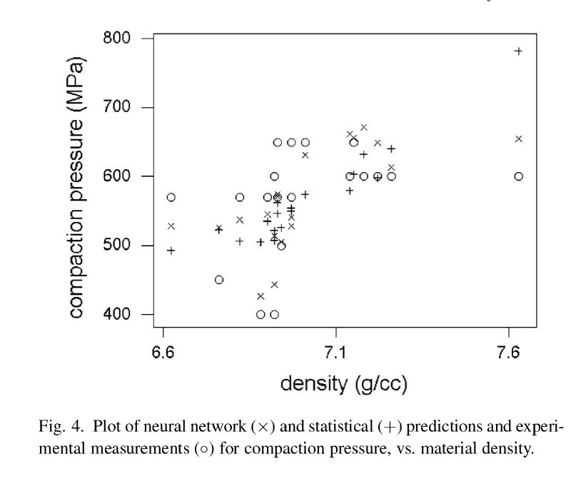


COMPARISON OF STATISTICAL AND NEURAL NETWORK MODELS
It can be seen that for most of the density values, the pressure value for O is approached more closely by the X than the +
Conclusion:
The system also demonstrates how neural network methods can be combined with rule-based inferencing for process modeling.
Finally the performance of the network was compared to regression analysis for solution of the inverse problem in P/ M.
This study has demonstrated that neural networks are particularly well suited to generating P/M materials selec- tion advice

Slide 26

REFERENCES
https://doi.org/10.1016/S0954-1810(99)00026-6.
https://doi.org/10.1016/j.asoc.2014.11.011
https://doi.org/10.1016/j.matdes.2011.02.049
https://doi.org/10.1016/S0924-0136(01)01198-0

